Slide 1
INDUSTRIAL INTERNSHIP DEFENSE & TECH PROFILE
Python Programming & Industry Systems
17-day intensive industrial training program at ESSAN SOLUTION exploring Core Python, OOP concepts, automation scripting, and backend workflows.
STUDENT INTERN
REGISTRATION / ROLL
INSTITUTION
DHANAPRAKASH
25580009 | 25LIT03
Muthayammal Polytechnic

Slide 2



OVERVIEW & VERIFICATION
Key Internship Identifiers
Candidate Info
College Department
Technology Track
Session Timeline
GOPI KRISHNAN V P
Muthayammal Polytechnic
Python Programming
04/05/2026 – 20/05/2026
Roll: 25LIT03
Reg: 25580009
Core & Advanced Python
17 Days Full Immersion

Slide 3


HOSTING ORGANIZATION
About ESSAN SOLUTION
Premier IT Solutions & Software Training Provider
ESSAN SOLUTION is a recognized technology company specializing in custom software services, web applications, and immersive industrial training programs designed for technical graduates.
Industry-standard software development and IT infrastructure solutions
Dedicated training wing for Python, Full-Stack development, and Databases
Active mentorship and collaborative student internship modules

Slide 4


SERVICE MATRIX
Core Industry Capabilities
Web Engineering
App Development
Digital Growth
Python & Academy
Custom enterprise CMS, responsive web architectures, and relational SQL backends.
Cross-platform mobile apps and operational inventory management solutions.
Corporate SEO visibility, social audience targeting, and brand strategy execution.
Mentored student programs covering Python, database connectivity, and backend logic.

Slide 5


CURRICULUM DEPTH
Python Architecture & Core Tooling
Python Fundamentals & Syntax
Variables, dynamic data types, conditional flow, and looping structures.
Data Structures & Collections
Comprehensive handling of Lists, Tuples, Dictionaries, and Sets.
Object-Oriented Programming (OOP)
Classes, objects, inheritance, encapsulation, and modular design.
File I/O & Database Connectivity
File handling, exception handling, and SQL database integration.

Slide 6
SYLLABUS ROADMAP
17-Day Intensive Python Progression
Stage 01
Stage 02
Stage 03
Stage 04
Days 1 – 4
Days 5 – 8
Days 9 – 13
Days 14 – 17
Python environment setup, core syntax, data types, and operators.
Functions, modules, collection data structures, and string operations.
Object-Oriented Programming, exception handling, and database queries.
Mini-project development, code review, debugging, and program sign-off.

Slide 7

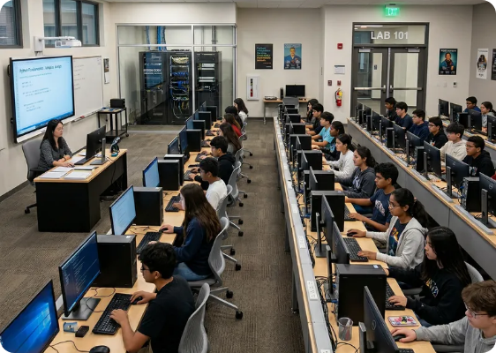
HANDS-ON APPLICATION
Python Capstone Project Implementation
Database-Backed Management System
Created a CRUD application connecting Python frontend logic to an SQLite/MySQL database.
Automated File & Data Parser
Engineered automated scripts to read, validate, and extract records from CSV/text logs.
Modular OOP Architecture
Implemented clean class hierarchies and error-handling routines for reliable execution.

Slide 8
SKILL ADVANCEMENT
Polytechnic Theory vs. Industry Practice
College Coursework
ESSAN SOLUTION Training
Theoretical Logic: Textbook algorithmic proofs.
Applied Python: Real-world scripting and modular design.
Curated Datasets: Small, zero-noise sample data.
Database Integration: Live SQL connections and CRUD workflows.
Individual Work: Isolated classroom
assignments.
Collaborative Coding: Version control & code reviews.
Grading Criteria: Semester exam scoring.
Deliverable Focus: Working application deployment.

Slide 9


KEY LEARNINGS
Key Competencies Acquired by Dhanaprakash
Core & OOP Python
Database & File I/O
Industry Readiness
Strong mastery of Python data structures, class encapsulation, inheritance, and reusable functions.
Hands-on integration with SQL tables, persistent storage operations, and exception management.
Exposure to corporate sprint cadences, modular debugging, and live software delivery standards.

Slide 10
Thank
You!

